Slide 1

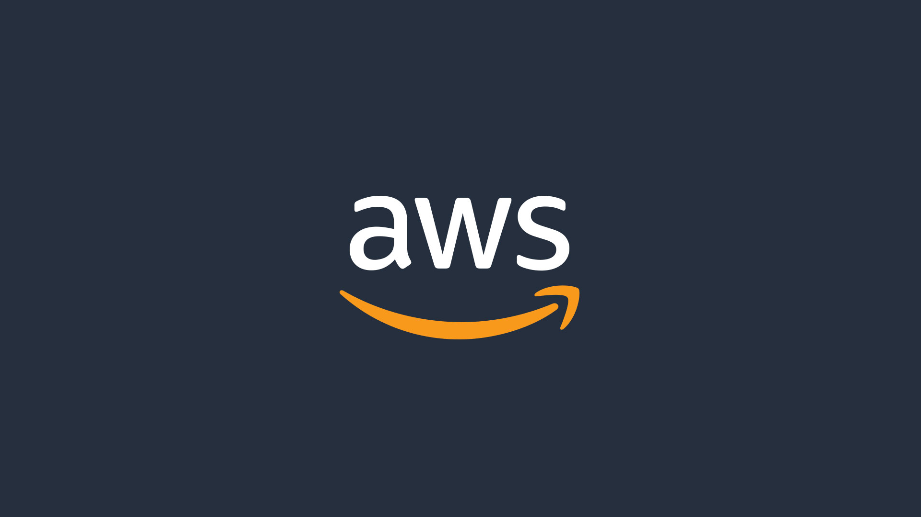
AMAZON WEB SERVICES NETWORKING
INSTRUCTOR: LAVISH ARORA
TEAM 4

Slide 2

Overview:
Introduction to AWS Networking
Key Concepts
Core Networking Services
Additional Networking Services
Summary

Slide 3
AWS Networking
AWS Networking refers to the set of services and concepts provided by Amazon Web Services to facilitate the secure, scalable, and reliable communication between applications, services, and users within the AWS cloud environment. Various AWS services make an AWS network complete, like Amazon VPC, Amazon EC2, Amazon Route 53, Load Balancers, Amazon Gateway, and more.
AWS offers a global infrastructure comprising multiple regions and availability zones.
Networking services in AWS include Virtual Private Cloud (VPC), Direct Connect, and Elastic Load Balancing, among others.
AWS networking ensures secure communication channels through features like security groups and network ACLs.
AWS offers various connectivity options such as Direct Connect for dedicated connections and VPN for secure communications.

Slide 4
Networking in cloud computing involves the integration and management of network resources, ensuring that data and applications can communicate effectively and securely across the cloud environment.
Key Points:
Scalability: Cloud networking allows for the dynamic scaling of resources to handle varying workloads.
Reliability: Proper network configurations ensure high availability and fault tolerance.
Security: Networking controls like security groups and ACLs protect against unauthorized access and threats.
Performance: Efficient networking improves data transfer speeds and reduces latency, enhancing overall application performance.
How AWS Approaches Networking:
Global Infrastructure: Deploy resources closer to users.
Virtual Private Cloud (VPC): Isolated networks with control over IP ranges.
Security: Features like security groups and network ACLs.
Connectivity Options: Direct Connect and VPN.
Integration: Seamless integration with other AWS services.

Slide 5
Amazon VPC (Virtual Private Cloud)
Subnets
Internet Gateway (IGW)
NAT Gateway/NAT Instances
Route Tables
Elastic IP Addresses
AWS Direct Connect
Elastic Load Balancing (ELB)
Amazon Route 53
AWS Transit Gateway
Amazon CloudFront
AWS PrivateLink
AWS Global Accelerator
Security Groups and Network ACLs
VPC Peering
AWS VPN

Slide 6
Regions and Availability Zones (AZs)
Regions: Geographic locations around the world where AWS has data centers.
Key Points:
AWS Regions are distinct geographical areas designed to enable users to deploy applications and resources closer to their end-users.
Each region operates independently and is isolated from other regions, providing data sovereignty and compliance benefits.
AWS has multiple regions worldwide, including North America, Europe, Asia-Pacific, South America, and more.
Example: "US East (N. Virginia)," "EU (Ireland)," "Asia Pacific (Sydney)."
Each region has its own set of services, pricing, and compliance certifications.
Availability Zones (AZs): Multiple, isolated locations within each region.
Key Points:
Availability Zones are physically separate data centers within an AWS region.
Each AZ is isolated but connected through low-latency links, providing high availability and fault tolerance.
AZs are designed to be independent of each other to prevent single points of failure. They have their own power, cooling, and physical security.
Deploying resources across multiple AZs can enhance application resilience and availability.
Example: A region like "US East (N. Virginia)" might have six AZs labeled "us-east-1a" to "us-east-1f."

Slide 7
AWS Networking Components
Virtual Private Cloud (VPC):
Definition: A VPC is a logically isolated virtual network within the AWS cloud where you can launch AWS resources in a secure environment.
Key Points:
Provides control over network configuration, including IP address ranges, subnets, route tables, and gateways.
Allows you to create a virtual network that closely resembles a traditional network in a data center.
Subnets:
Definition: Subnets are segments of a VPC's IP address range where you can place AWS resources, such as EC2 instances.
Key Points:
Subnets can be classified as public or private based on their accessibility from the internet.
Public subnets have direct access to the internet via an Internet Gateway, while private subnets do not.

Slide 8
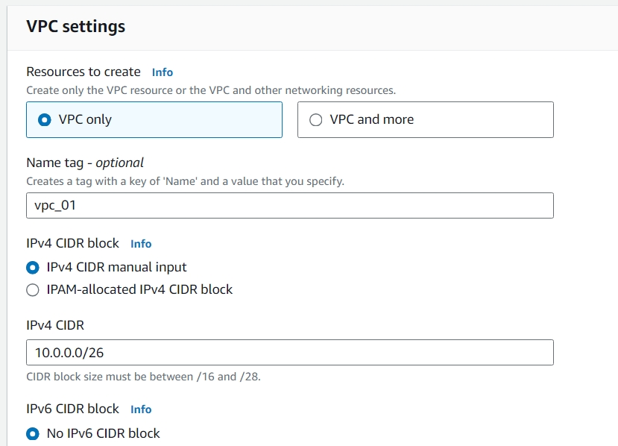
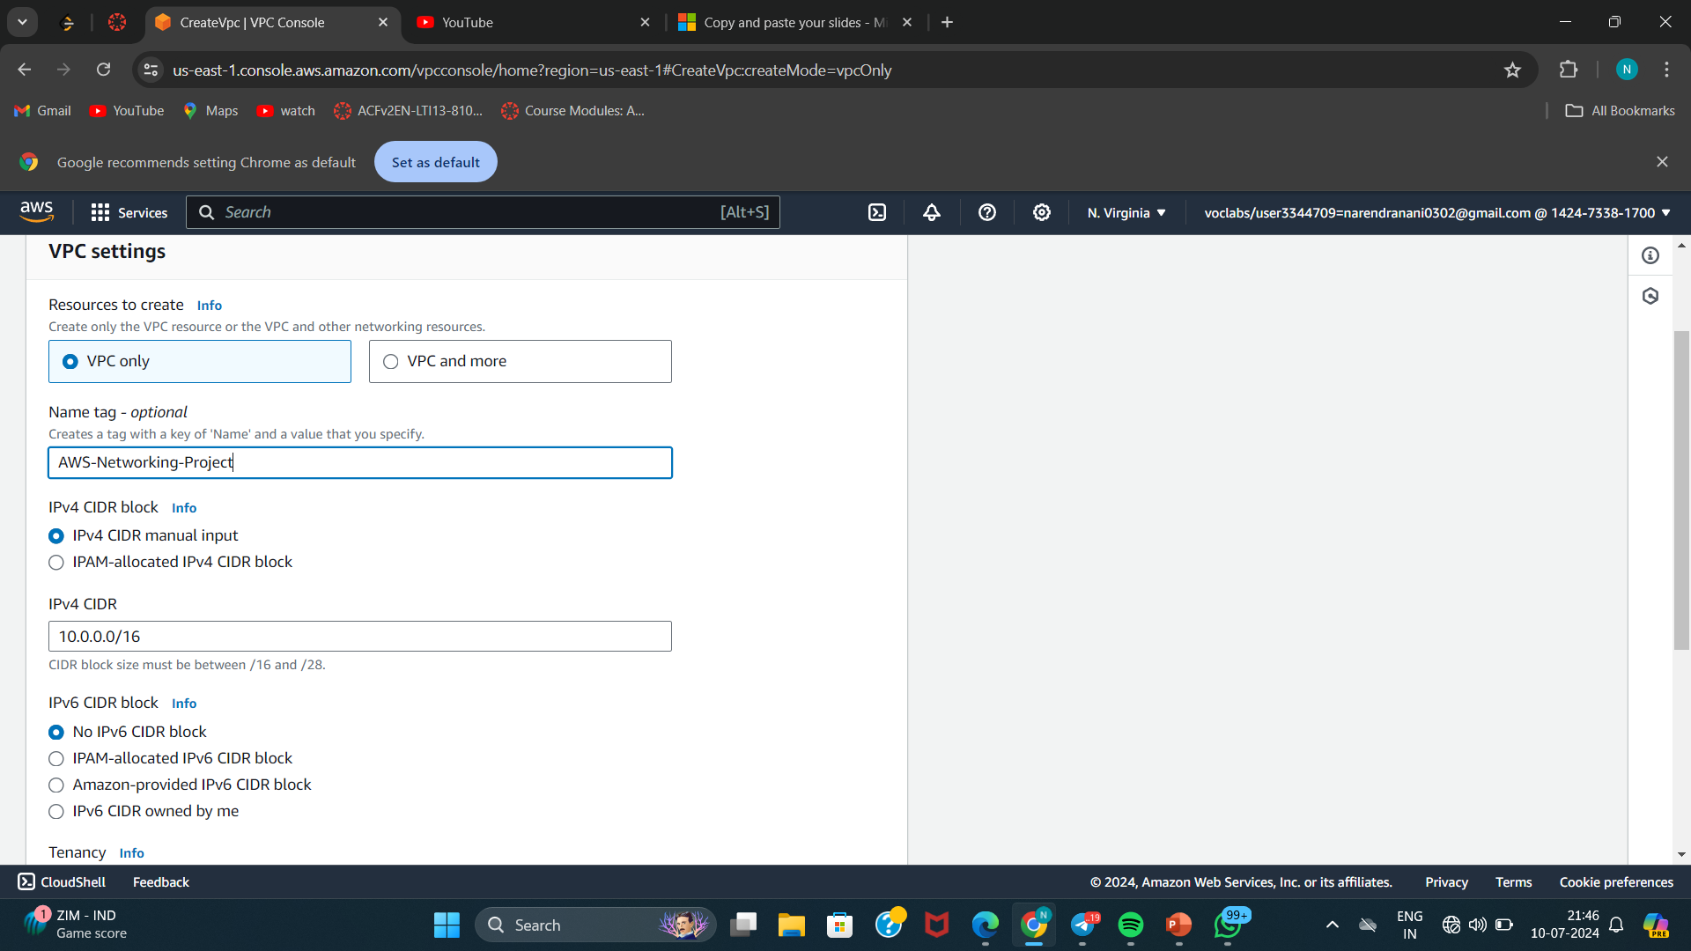
Create the VPC and Subnets Layout:
VPC (Virtual Private Cloud): A virtual network dedicated to your AWS account where you can launch AWS resources in a logically isolated section of the AWS cloud.
Subnets: Segments within a VPC that allow you to group resources based on security and operational needs, each containing a range of IP addresses.
How to create VPC:
1)Come to VPC dashboard there we can see default VPC is already created.
2)Now click on create VPC and give name tag like
AWS-Networking-Project
3)Give Ip like 10.0.0.0/16 and checkmark no ipv6 cidr block
4)Then click on create to create your VPC.

Slide 10
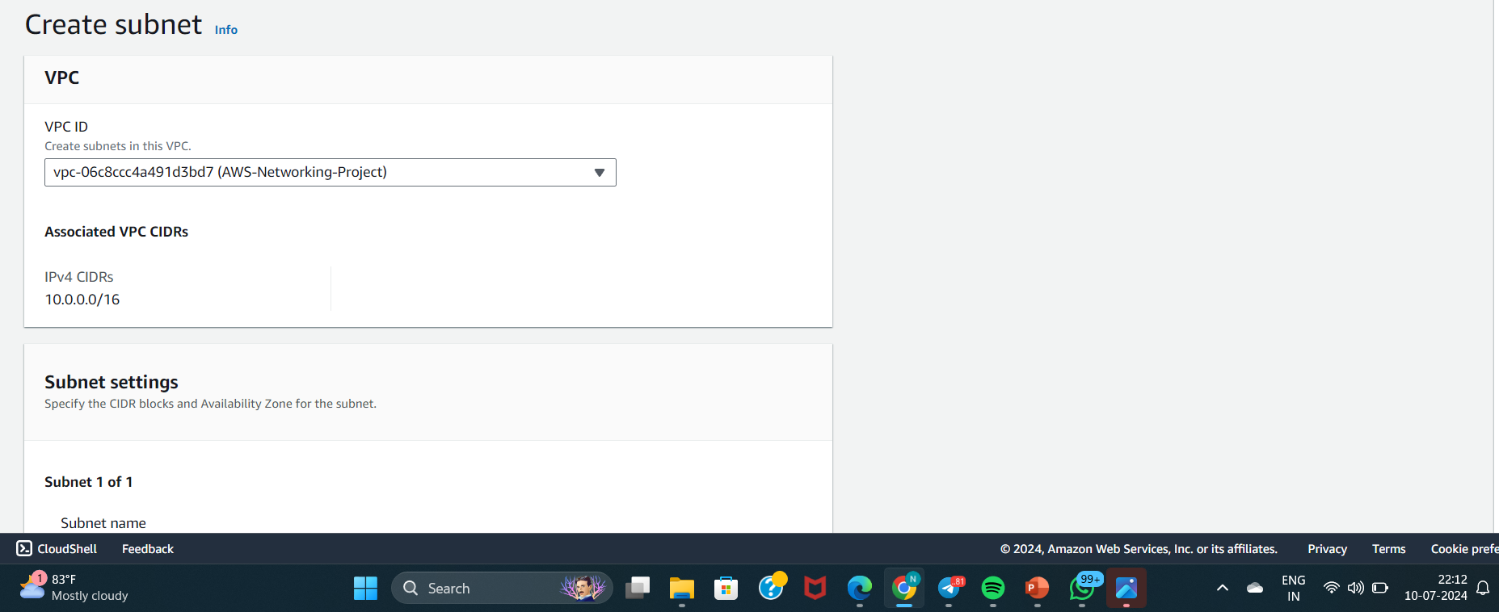
How to create Subnet:
1)Click on create subnet and associate it with vpc.
2)Then add name and select availability zone like a1
3)Now we decide range of Ip for each subnet.
4)Then click on create.
In this way we creates 4 subnets in which 2 are public and 2 are private

Slide 11
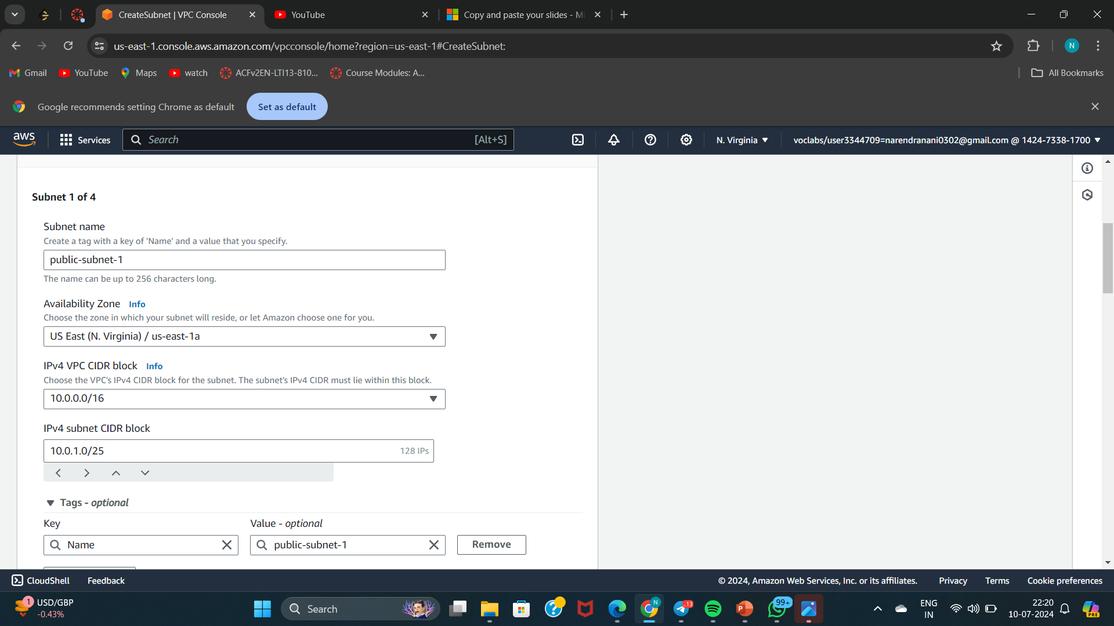
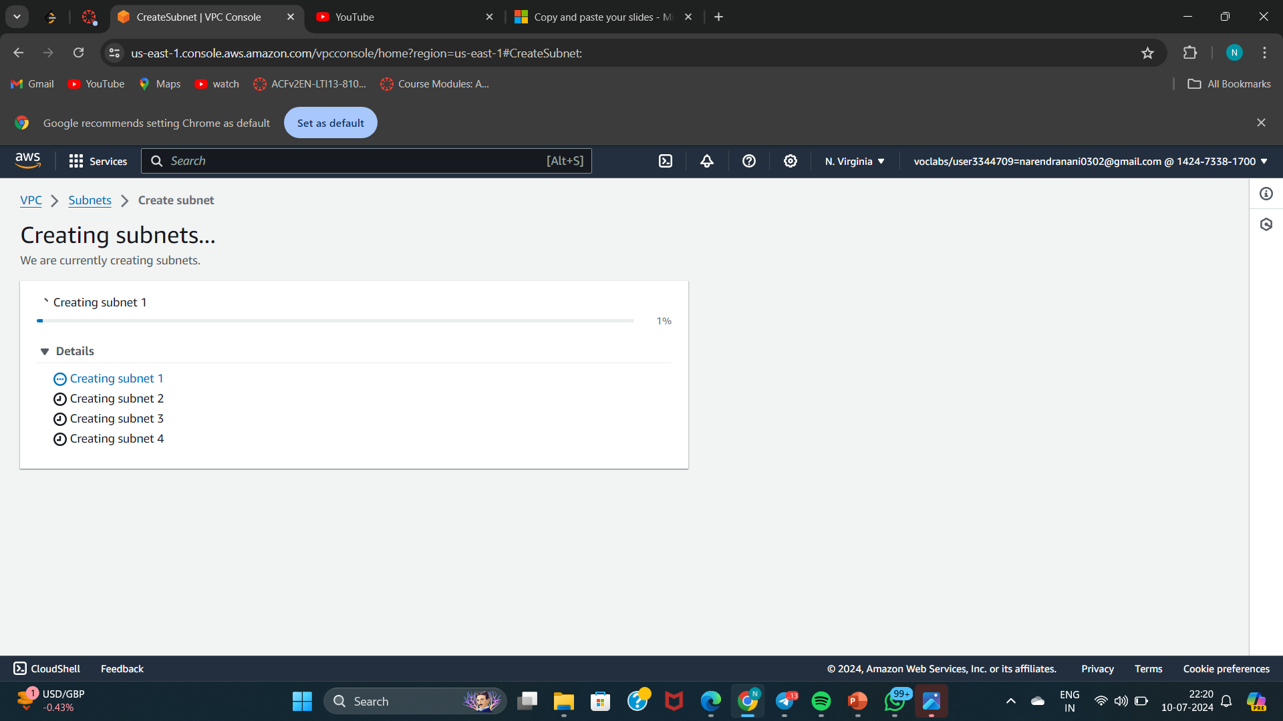
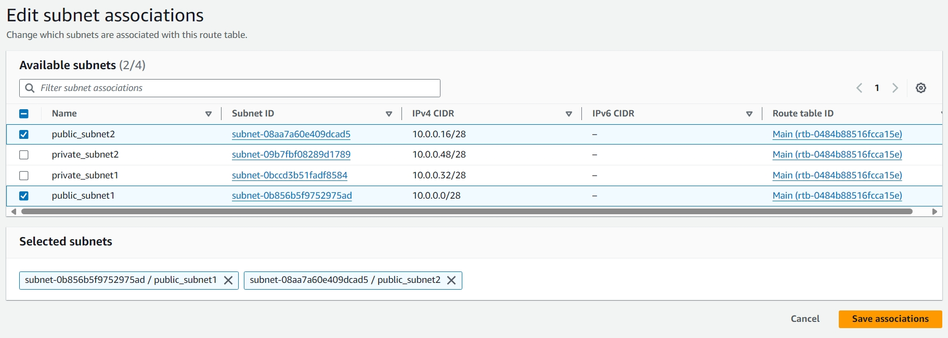
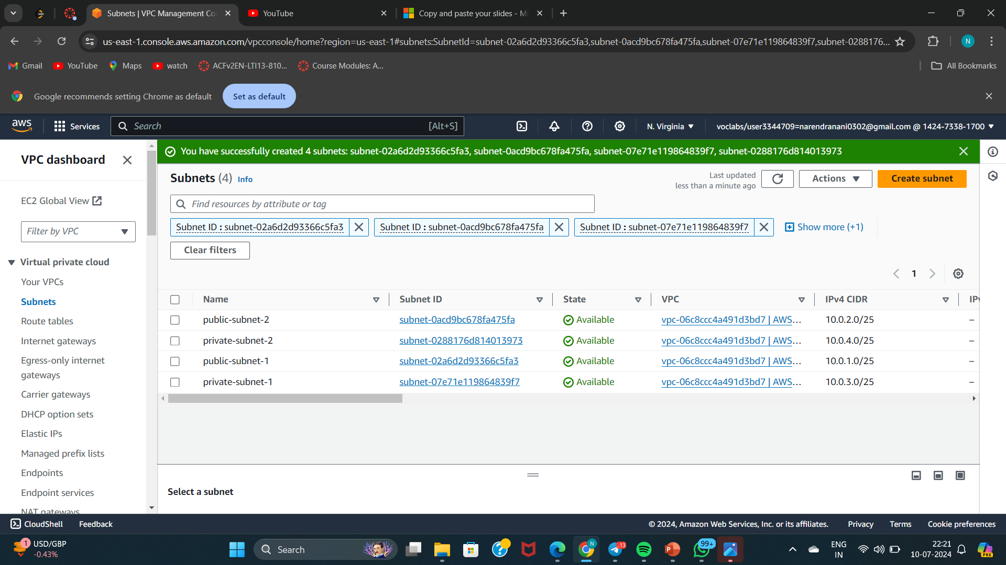

Slide 12
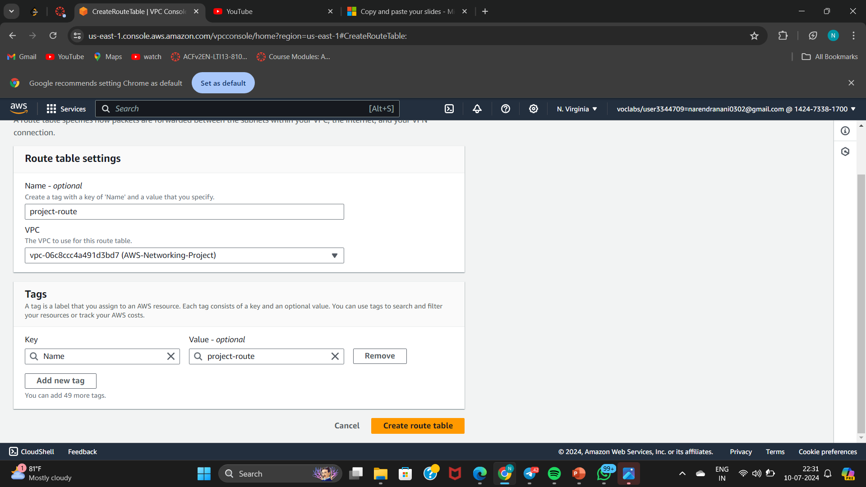
How to setup Route Table:
Come to route table and we can observe the VPC that is created. Now select manual VPC.
Click create route table

Slide 13
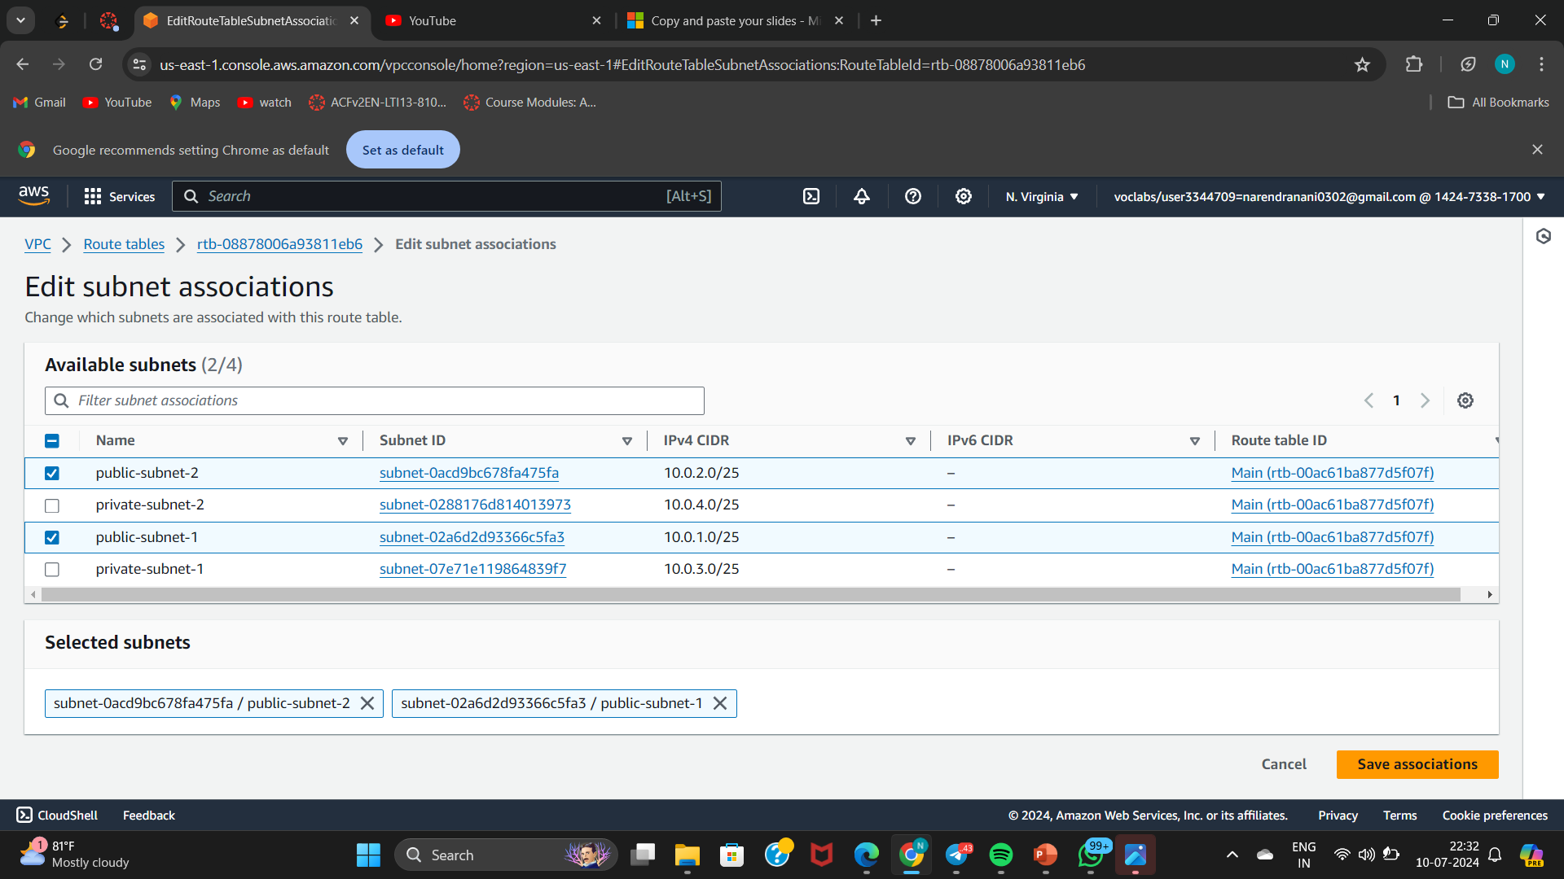
Click on subnet association and then click on edit. Now checkmark 2 public subnet public 1,2 and click on save.

Slide 14
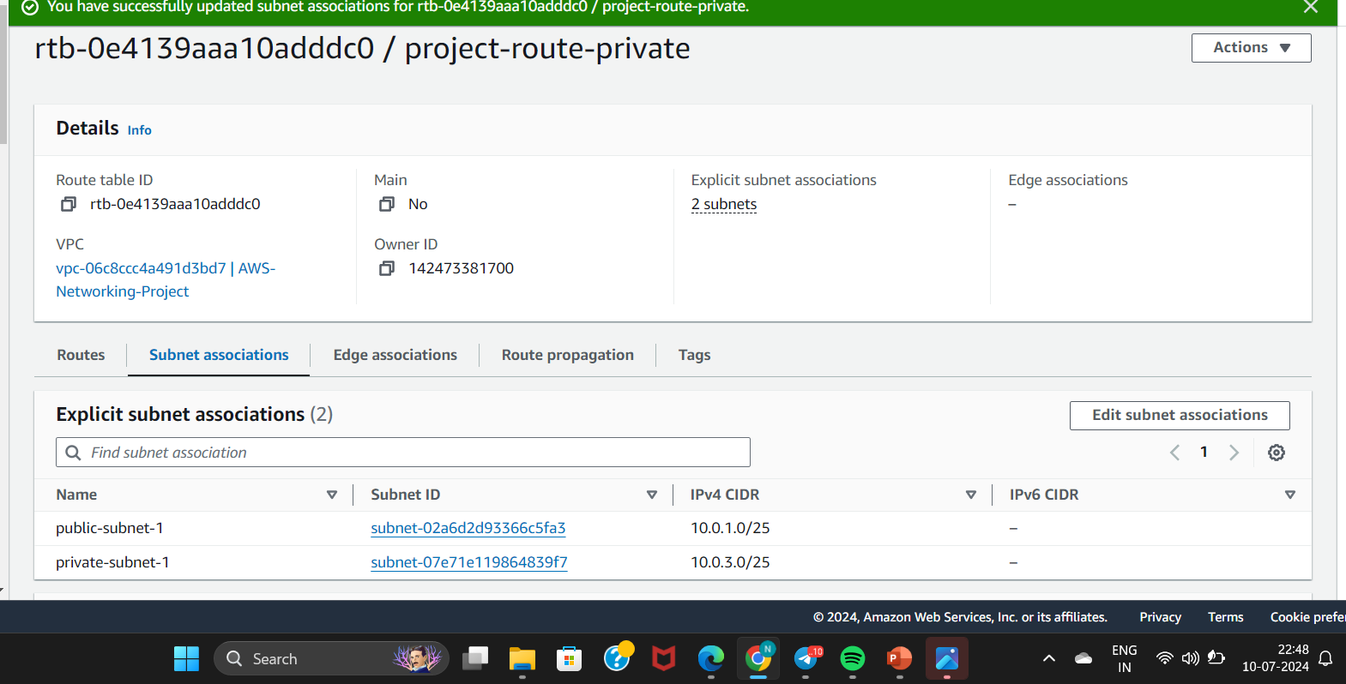
Same way create route table for private subnet 1,2 and click save.4

Slide 15
Add Networking Components
Internet Gateway: An Internet gateway is a horizontally scaled, redundant, and highly available VPC component that allows communication between instances in your VPC and the Internet. It therefore imposes no availability risks or bandwidth constraints on your network traffic.
NAT Gateway: Place it in the public subnet and connect it to the private subnets.
How to create an Internet Gateway:
1) Navigate to the AWS console -> Services
2) Under the Networking & Content Delivery section, choose VPC.
3) Navigate to Virtual Private Cloud -> Internet Gateways. Click Create Internet Gateway.
4) Type a name in the Name tag text box and click Yes, Create.
5)Click Attach to VPC and Select your VPC from the Name tag drop-down list and click Yes, Attach.

Slide 16
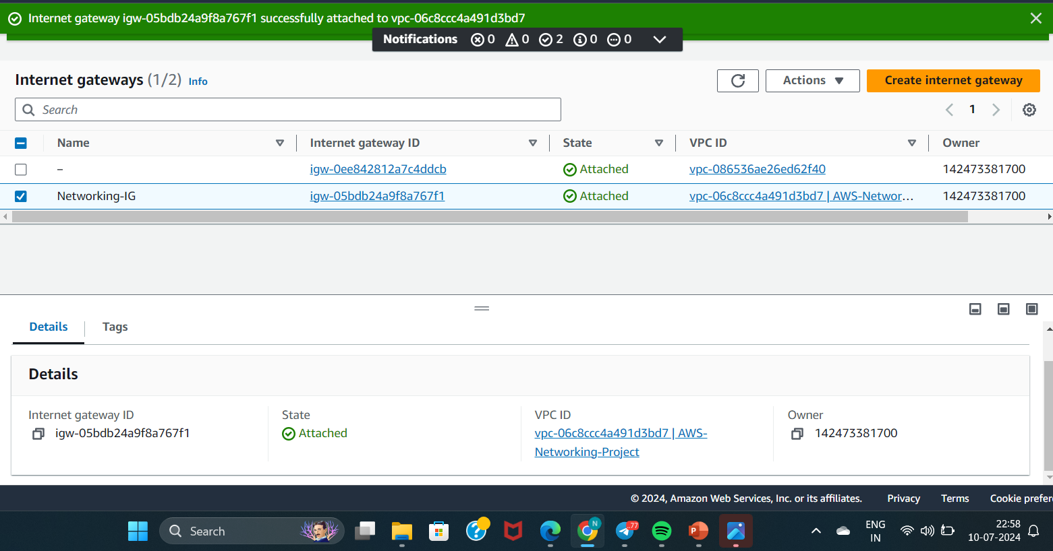
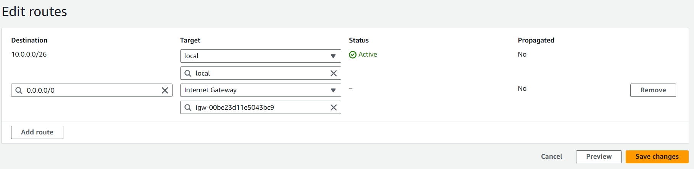

Slide 17
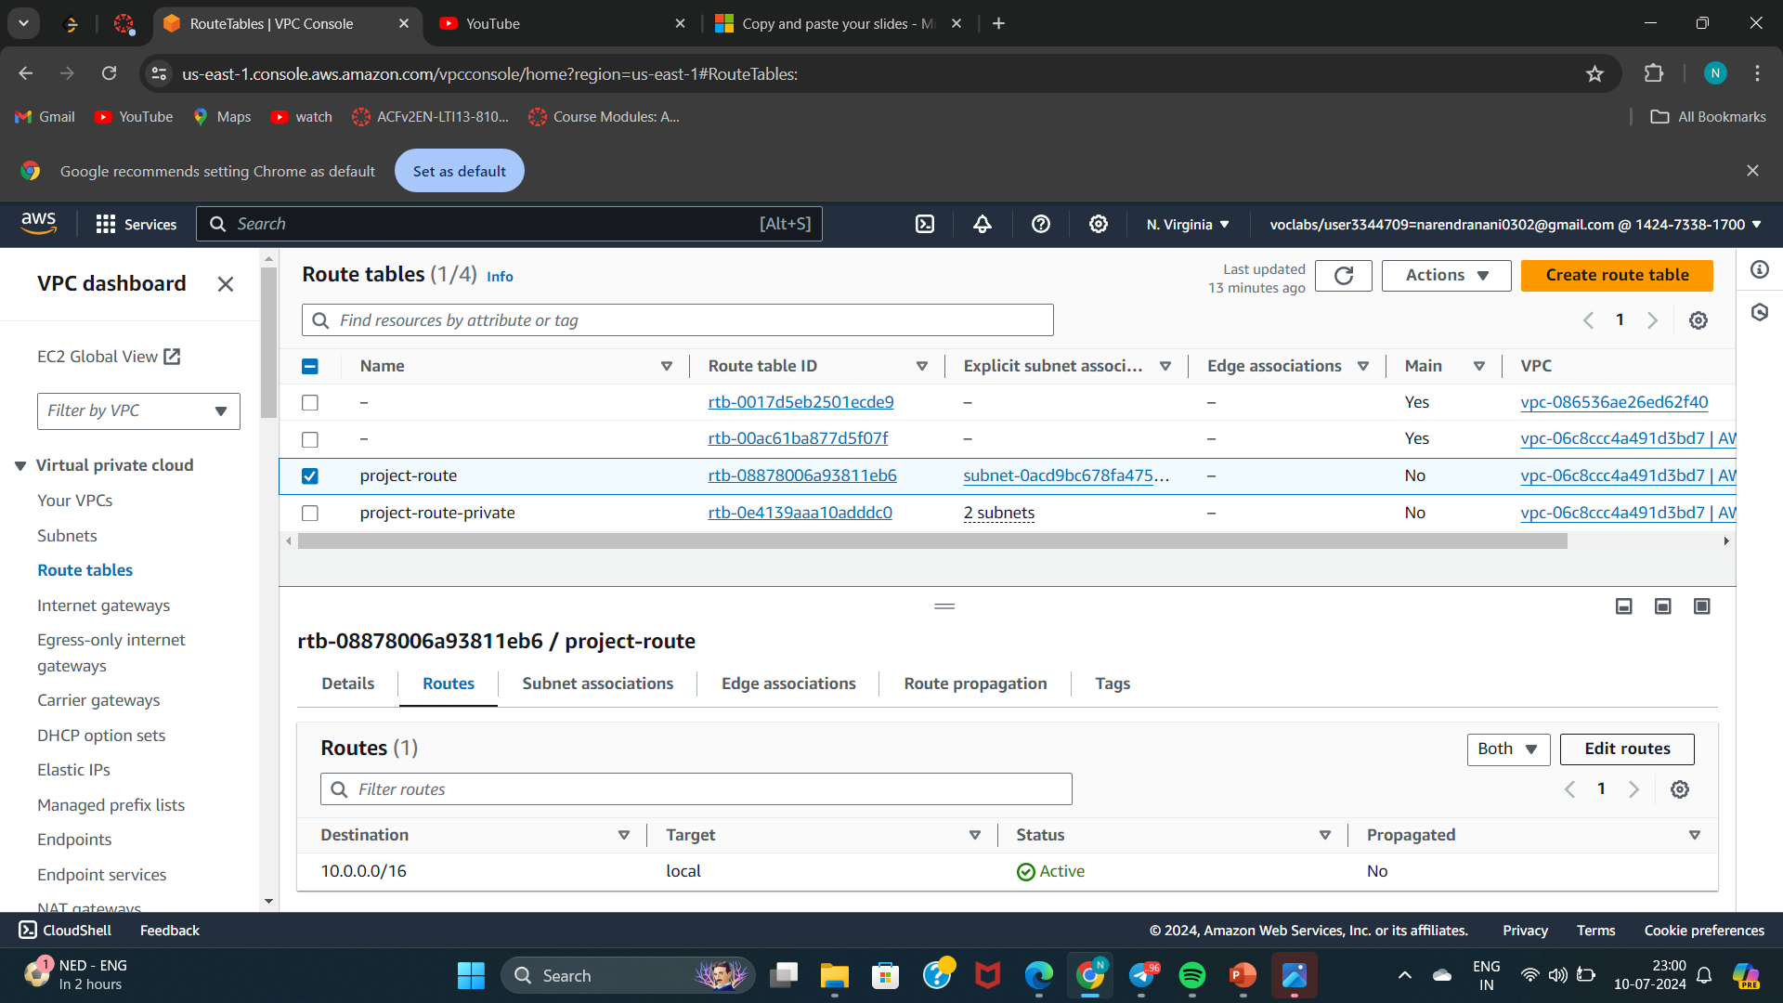
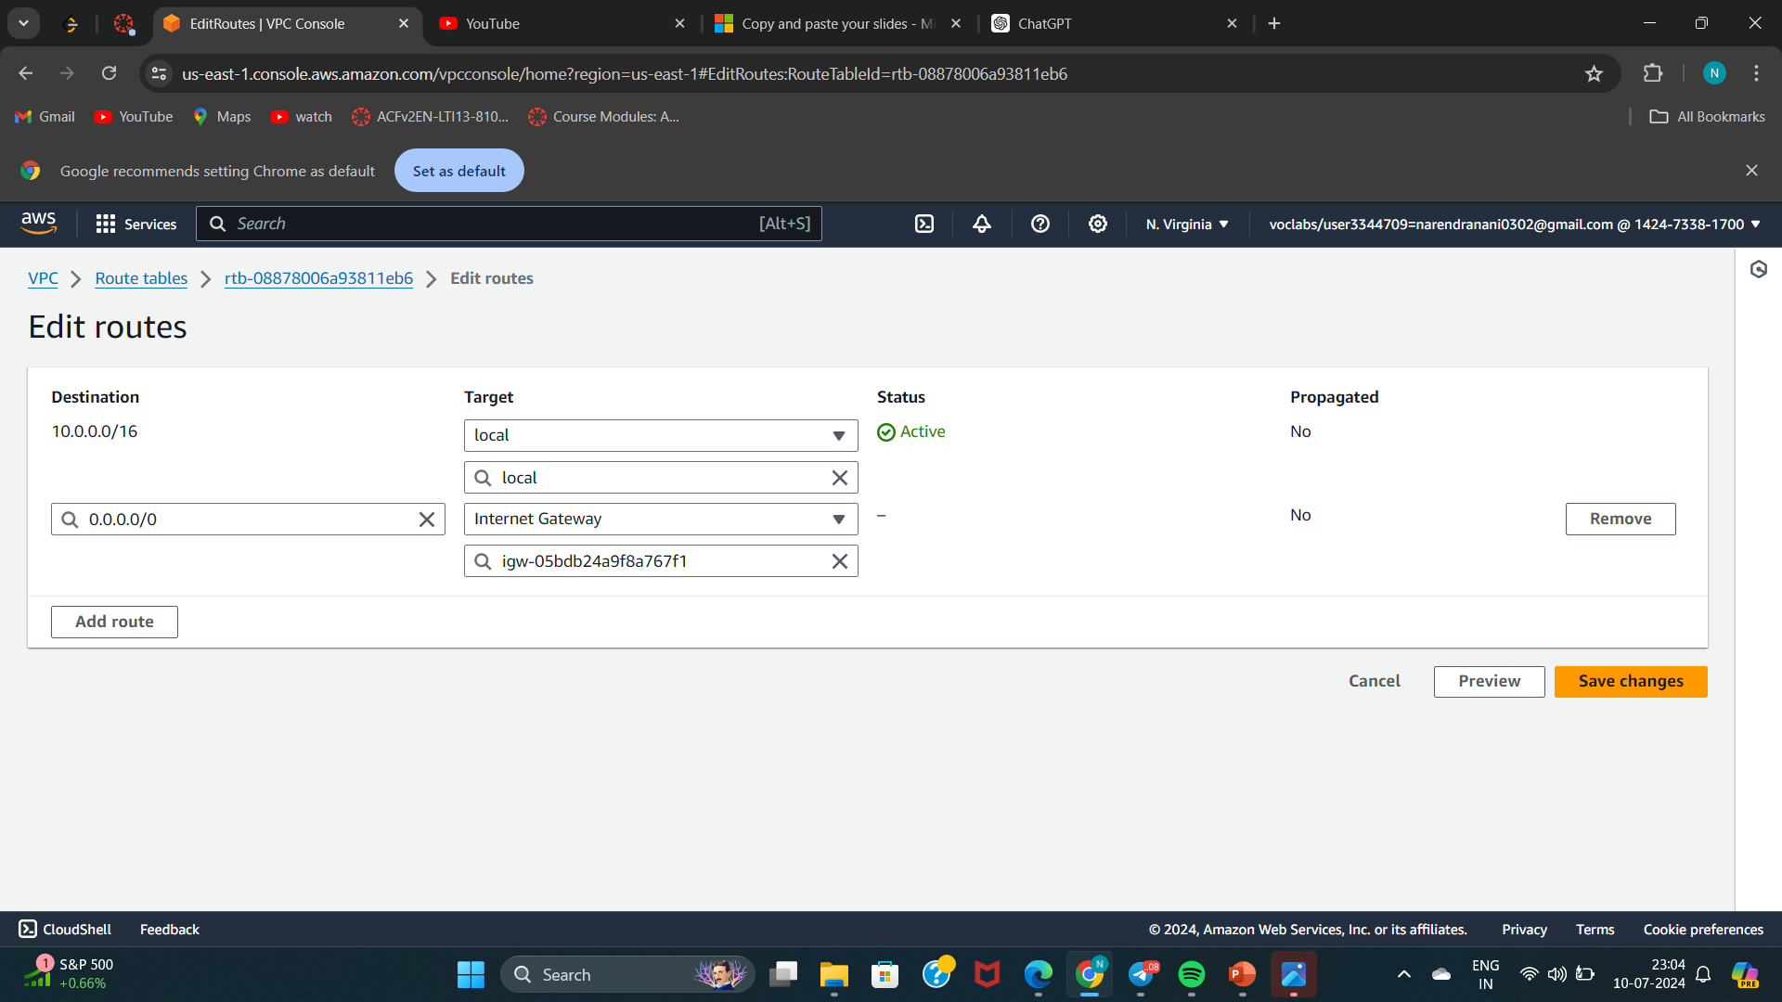
Update Route Table
Navigate to Route Tables
Select the Route Table
Edit Routes
Add Internet Gateway Route

Slide 18
Add EC2 Instances:
Amazon Elastic Compute Cloud (Amazon EC2) is a web service that provides resizable compute capacity in the cloud. It is designed to make web-scale cloud computing easier for developers.
Web Servers: Place EC2 instances in the public subnets to handle incoming web traffic.
Application Servers: Place additional EC2 instances in the private subnets for application logic processing.
How to Create a EC2 Instance:
1)Navigate to EC2 Console
2)Click on the launch instance to create the instance
3)Now choose an instance type and select the virtual machine
4)Configure the storage and make sure to tag the instance
5)Access the build in security by creating a required security group
6)Now enable SSH access with a key.

Slide 19
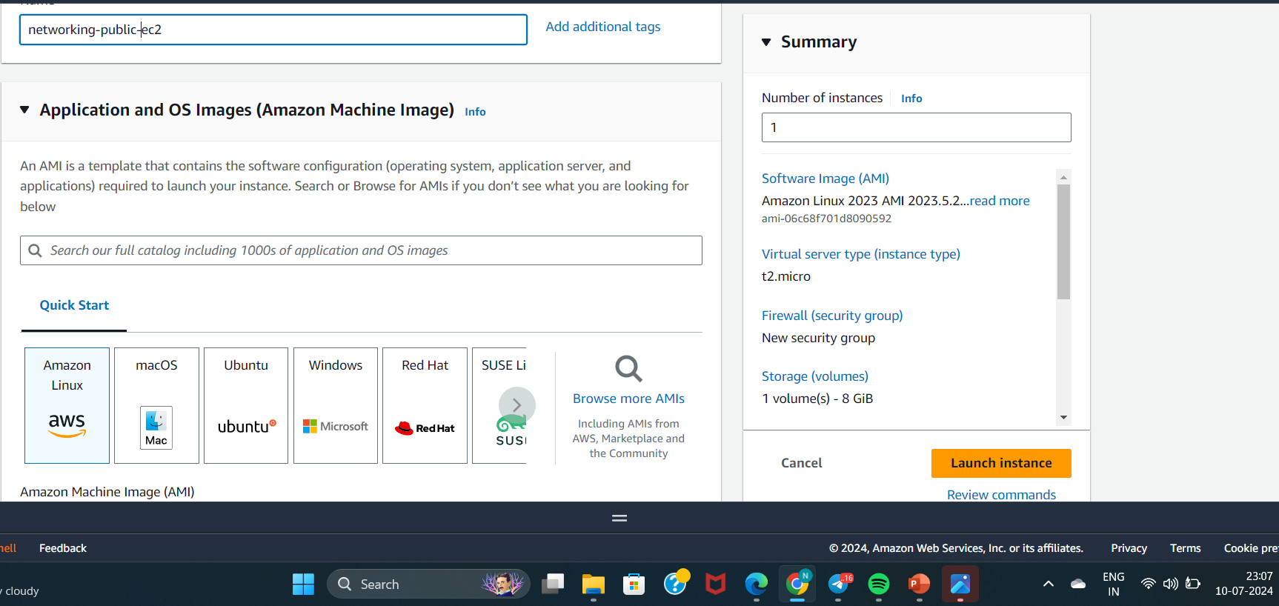
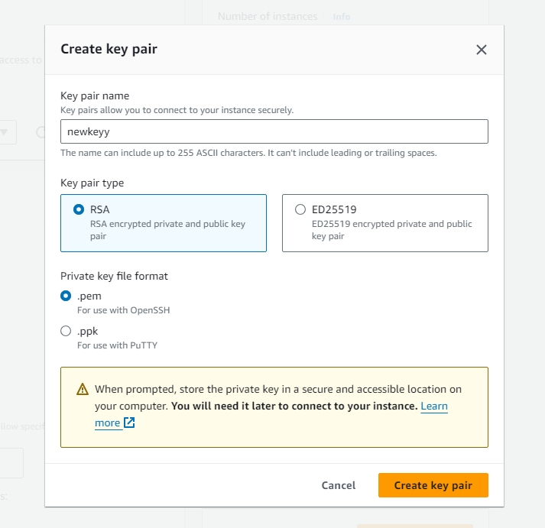

Slide 20
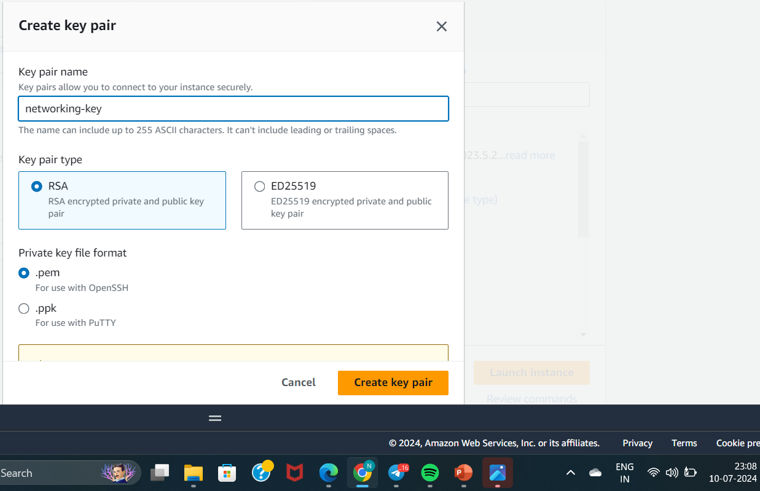
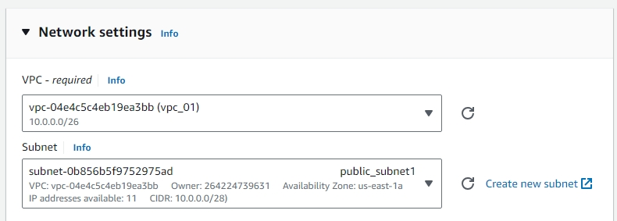

Slide 21
Add Load Balancer:
Elastic Load Balancer: Draw the load balancer above the web servers and connect it to the EC2 instances in the public subnets.
Before creating a load balancer, ensure you have a VPC, subnets, and instances set up.
How to add Load Balancer:
1)Navigate to the EC2 Dashboard and In the left-hand menu under Load Balancing, click on Load Balancers.
2)Select the type of load balancer. For a web application, you'll typically choose Application Load Balancer (ALB) and Click Create.
3)Enter a name for your load balancer. And choose the IP version that is required.
4)Configure Listeners and Routing and Create Target Group
5)Select the EC2 instances you want to include in the target group.
6)Review all the settings you have configured and Click Create.
7)Once created, navigate back to the Load Balancers section in the EC2 dashboard. Select your newly created load balancer and Check the Description tab to ensure that the load balancer is in a state: active.

Slide 22
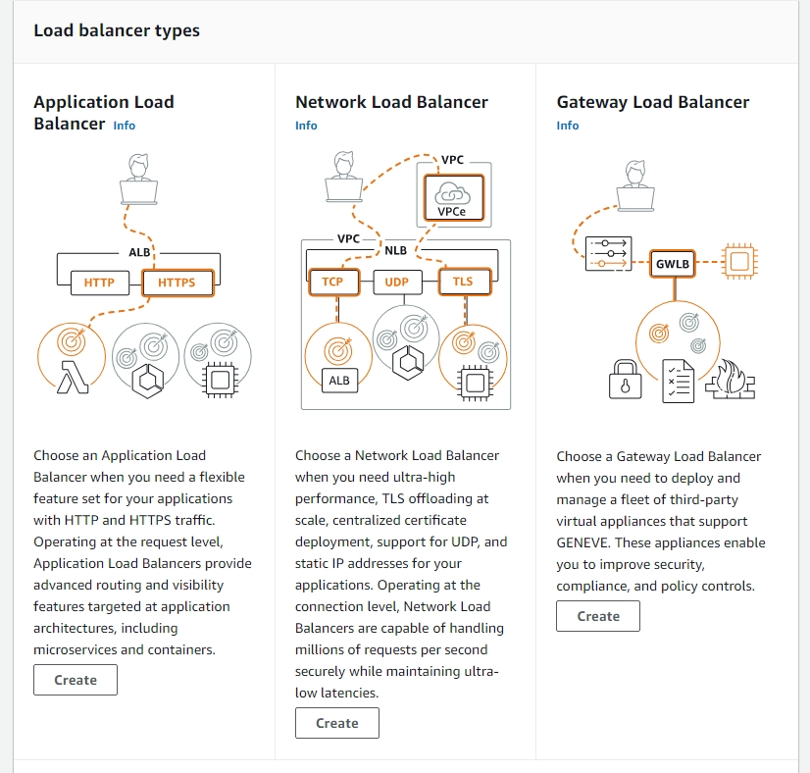
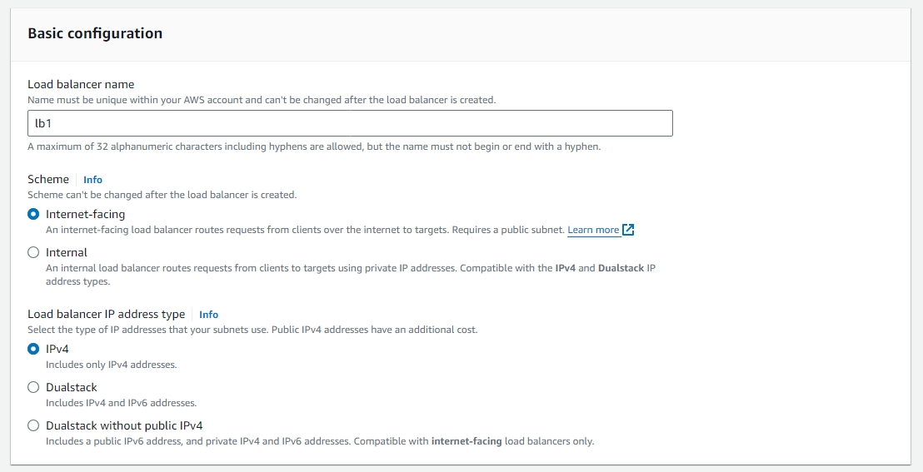
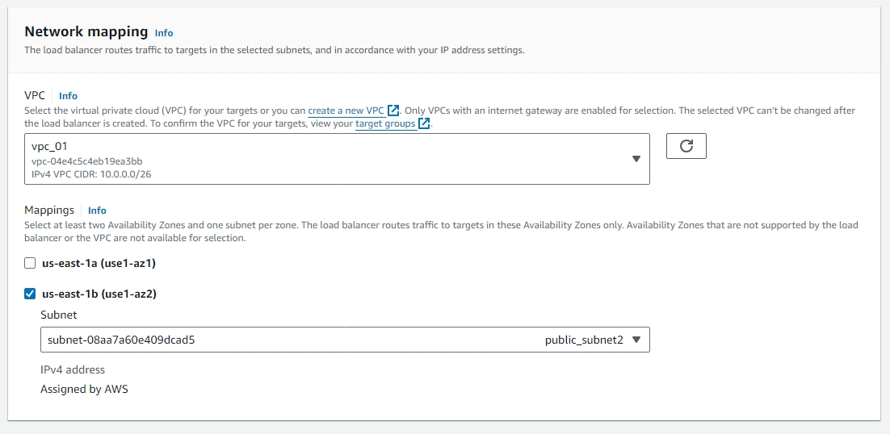

Slide 23
Configuring Route 53 in AWS Console:
1)In the Services menu, click on Route 53 to open the Route 53 Dashboard.
2)Click on the Hosted zones button in the left-hand menu and Click the Create hosted zone button
3) Configure Hosted Zone Settings
Domain Name: Enter the domain name you want to manage (e.g., example.com).
Type: Select Public Hosted Zone for public domains.
Click the Create button.
4)Add Record Sets
Select Hosted Zone: Click on the hosted zone you just created.
Create Record Set: Click the Create Record Set button.
5)Configure A Record for Load Balancer
Name: Leave it blank to use the root domain (e.g., example.com).
Type: Select A - IPv4 address.
Alias: Select Yes.
Alias Target: Select your Elastic Load Balancer from the list.
6)Click the Create button.

Slide 24
Key Networking Services
Amazon VPC:
Definition: Provision a logically isolated section of the AWS cloud.
Key Points:
Full control over virtual networking environment.
Customize network configurations and security settings.
AWS Direct Connect:
Definition: Establish a dedicated network connection to AWS.
Key Points:
Provides a dedicated, private connection.
Improves bandwidth throughput and reduces latency.
AWS Transit Gateway:
Definition: Connect VPCs and on-premises networks through a central hub.
Key Points:
Acts as a central hub for traffic management.
Simplifies network architecture.

Slide 25
Elastic Load Balancing (ELB):
Definition: Distributes incoming application traffic across multiple targets.
Key Points:
Enhances fault tolerance by distributing traffic.
Supports multiple types of load balancers
AWS VPN:
Definition: AWS VPN securely connects your on-premises network or device to AWS using a virtual private network.
Key Points:
Supports both Site-to-Site VPN and Client VPN connections.
Ensures secure and encrypted connectivity.
AWS CloudFront:
Definition: Amazon CloudFront is a fast content delivery network (CDN) service that securely delivers data, videos, applications, and APIs to customers globally with low latency and high transfer speeds.
Key Points:
Distributes content globally through edge locations.
Enhances performance and reduces latency.

Slide 26
CONCLUSION
AWS provides robust networking capabilities through services like Amazon VPC, which allows users to create isolated virtual networks with defined IP ranges, subnets, and route tables. Regions and Availability Zones offer geographic redundancy and high availability, ensuring resilience against failures. Features like Internet Gateway and NAT Gateway facilitate secure internet access for instances in private subnets, while Security Groups and Network ACLs provide granular control over inbound and outbound traffic, enhancing security. Services such as AWS Direct Connect and VPN enable secure and direct connections to AWS resources, ideal for hybrid cloud deployments. Elastic Load Balancing (ELB) and AWS CloudFront optimize application performance and distribution, while Route 53 offers scalable DNS management. AWS Transit Gateway and Private Link simplify network architecture and improve scalability for large-scale deployments. These features collectively empower users to build highly available, scalable, and secure networks tailored to their specific application and business needs on AWS.

